Slide 1

Pipelining
Data Hazard

Slide 2
MIPS Execution Cycle
Obtain instruction from program storage (IF)
Instruction
Fetch
Instruction
Decode
Determine required actions and registers (ID)
Execution
cycle
Compute result value or status (EX)
Memory
Access
Deposit results in storage for later use (MEM)
Write Back Cycle
Update Register File (WB)

Slide 3
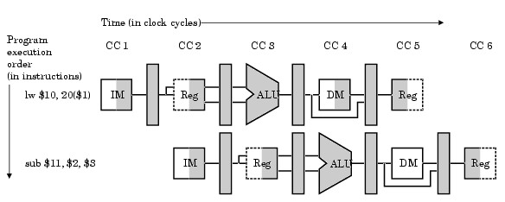
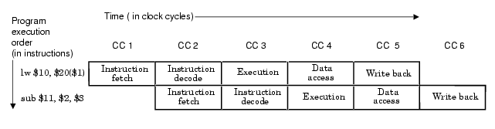
Visualizing Pipelining

Slide 4
Its Not That Easy for Computers
Limits to pipelining: Hazards prevent next instruction from executing during its designated clock cycle
Structural hazards: HW cannot support this combination of instructions (single person to fold and put clothes away)
Data hazards: Instruction depends on result of prior instruction still in the pipeline (missing sock)
Control hazards: Pipelining of branches & other instructionsstall the pipeline until the hazardbubbles” in the pipeline

Slide 5
Speed Up Equation for Pipelining
CPI_{pipelined} = Ideal CPI + Pipeline stall clock cycles per instr
Speedup = Ideal CPI x Pipeline depth Clock Cycle_{unpipelined}
Ideal CPI + Pipeline stall CPI Clock Cycle_{pipelined}
Speedup = Pipeline depth Clock Cycle_{unpipelined}
1 + Pipeline stall CPI Clock Cycle_{pipelined}
x
x

Slide 6
Three Generic Data Hazards
Instr_{I} followed by Instr_{J}
Read After Write (RAW) Instr_{J} tries to read operand before Instr_{I} writes it

Slide 7
Three Generic Data Hazards
Instr_{I} followed by Instr_{J}
Write After Read (WAR) Instr_{J} tries to write operand before Instr_{I} reads I
Gets wrong operand
Can’t happen in DLX 5 stage pipeline because:
All instructions take 5 stages, and
Reads are always in stage 2, and
Writes are always in stage 5

Slide 8
Three Generic Data Hazards
Instr_{I} followed by Instr_{J}
Write After Write (WAW) Instr_{J} tries to write operand before Instr_{I} writes it
Leaves wrong result ( Instr_{I} not Instr_{J} )
Can’t happen in DLX 5 stage pipeline because:
All instructions take 5 stages, and
Writes are always in stage 5

Slide 9
Forwarding to Avoid Data Hazard
Time (clock cycles)
I
n
s
t
r.
O
r
d
e
r
add r1,r2,r3
sub r4,r1,r3
and r6,r1,r7
or r8,r1,r9
xor r10,r1,r11

Slide 10
HW Change for Forwarding

Slide 11
Data Hazard Even with Forwarding
Time (clock cycles)
I
n
s
t
r.
O
r
d
e
r
lw r1, 0(r2)
sub r4,r1,r6
and r6,r1,r7
or r8,r1,r9
Notes:
MIPS actutally didn’t interlecok: MPU without Interlocked Pipelined Stages

Slide 12
Data Hazard Even with Forwarding
Time (clock cycles)
I
n
s
t
r.
O
r
d
e
r
lw r1, 0(r2)
sub r4,r1,r6
and r6,r1,r7
or r8,r1,r9

Slide 13
Software Scheduling to Avoid Load Hazards
Try producing fast code for
a = b + c;
d = e – f;
assuming a, b, c, d ,e, and f in memory.
Slow code:
LW Rb,b
LW Rc,c
ADD Ra,Rb,Rc
SW a,Ra
LW Re,e
LW Rf,f
SUB Rd,Re,Rf
SW d,Rd
Fast code:
LW Rb,b
LW Rc,c
LW Re,e
ADD Ra,Rb,Rc
LW Rf,f
SW a,Ra
SUB Rd,Re,Rf
SW d,Rd

